Slide 1
Big Data Analysis System
for Medicare Data
CS8674 - Prof. Ian Gorton
Timothy Cowley, Brian Gillespie, Zheyu Jin,
Hunter Jorgensen, Doyle Ravnaas, Joshua Shaham

Slide 2
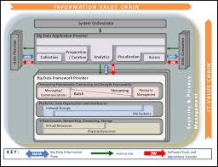
Basic Aims
National Institute of Standards and Technology (NIST) Big Data Reference Architecture
Develop a use case on public data set to test/validate NIST Reference Architecture
Chose Medicare Part B Data Analysis
Public data sets
Considerable scope for creative analysis
Sufficient data size to explore ‘big data’ technologies and cloud-based distributed systems

Slide 3
Medicare Data Sets
Raw data on medicare providers and procedures performed
Locations, costs (median, std), number and type of procedures
Spreadsheet format (xls, easily converted to csv)
Size of data:
Raw: 10 Million rows of data in CSVs for 2012
Solr index: ~2 Gig
Cassandra tables: ~4 Gig
Notes:
(Doyle)
The CMS government site has tons of public use data sets. We focused on the 2012 aggregated provider utilitization data.
This data set lists providers and the procedures they charged medicare for, along with related information like their address, the doctor credentials, how many patients received that service, and some statistics - averages and standard deviations on what was charged, what the patient paid and what medicare paid.
The data is exported in 10 or so very large Excel spreadsheets. We converted the spreadsheets to comma separated value files, since that’s easy to ingest and process.
The raw size of the data was around 10 million rows in the combined CSVs.
The search index we built from the data was nearly 2Gig in size
The combined database table size was nearly 4 Gig in size

Slide 4

Collection/Preparation
Visualization/Access/Analytics
Medicare Provider data, 2012 (.xls/csv)
Annual Data
Ingest & Cleaning
Web
Browser
Batch
Interactive
Data Consumers
Cluster computing
Web site and service
Spark Client
Cassandra/Solr Client
External Reference data sets, eg: zip to county
Processing Layer
Cassandra
Solr
S3
Data Providers
Data Layer
Infrastructure: AWS {EC2, S3, EBS}
Notes:
(Doyle)
So before we demo a few things, here’s a peek behind the curtains at the high level architecture.
The middle portion represents our three tier hierarchy of client, server and database with the backend running in the Amazon cloud.
On this side is our batch mode flow - how do we get the various bits of data processed and loaded into the backend so it can be accessed interactively by user. Batch data included the 2012 provider data into Solr and Cassandra, as well as the various processing output of the machine learning and analytical processes - generally, this is data that needs to be processed once a year. The batch mode processes can be as fancy as Spark or as simple as running a java app against the cloud hosted backend.
The interactive flow represents what happens when a user accesses the web site via the browser. The user picks one of the web site pages, the front end issues calls to the web service, the web service has a data access layer that knows how to talk to the backend to provide the data response. The query results come back and the user sees the formatted data.
We used spring MVC and tomcat to run the website and service, and we used various Amazon cloud services overall to host all of the server side.
You’ll hear more about each of the major components in our flows, but first I’ll turn it over to Hunter to run us though a couple of our use cases.

Slide 5
Demo time!
Notes:
Demo the fancy use cases, then go into deep dives

Slide 6


User Interface

Slide 7
Developing a UI from Scratch
No previous UI/web experience!
Choosing a visualization software
D3 vs Tableau
D3 -> lightweight, free, endlessly modifiable
Tableau -> great enterprise software, not-free, easy to work with
Obstacles to our success
Learning lots of new technology!
Libraries/frameworks to handle what we wanted
A visually appealing UI
Dealing with demands from back end and behavior of users
Notes:
last bullet: all of these had common patterns, we just had to look them up and apply them to our project

Slide 8
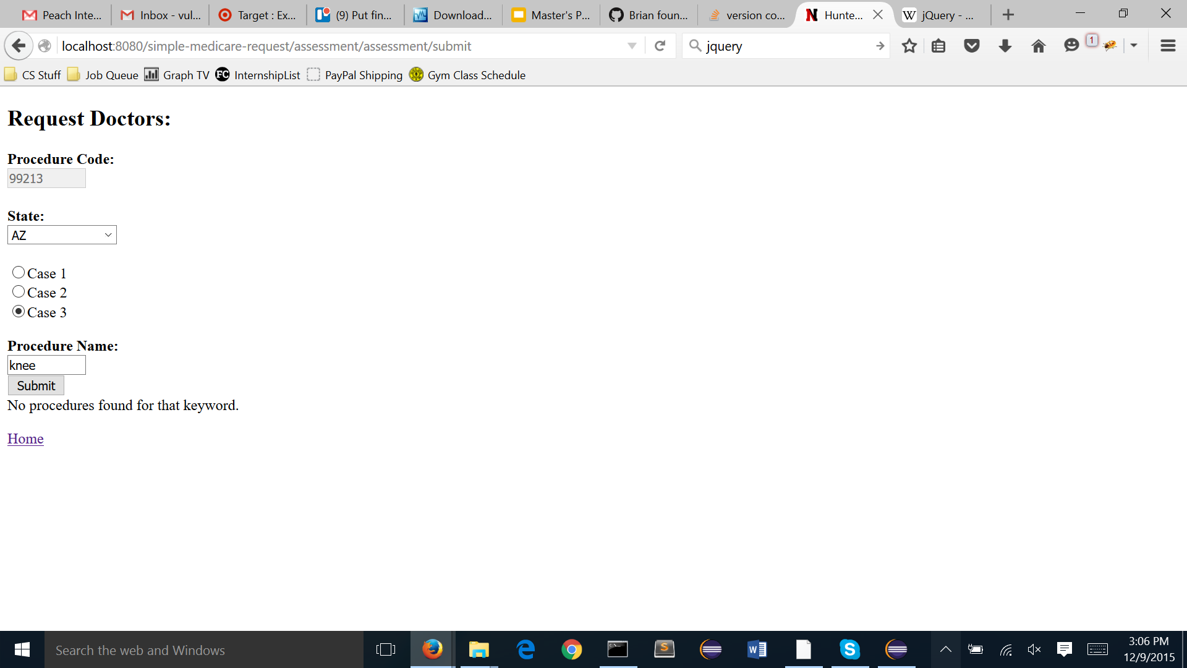

Slide 9
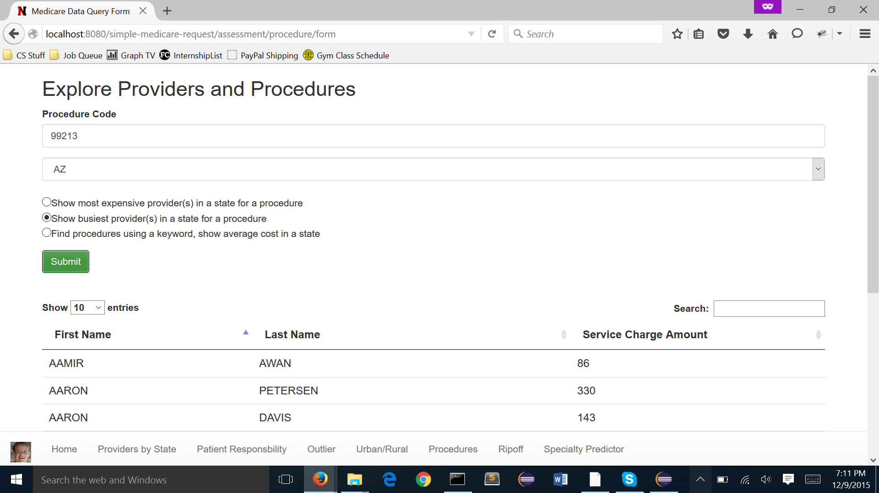

Slide 10
Developing the UI
Libraries and what they do
jQuery
Bootstrap
DataTables
New UI features over time
Consistent UI across all pages
Easy navigation
Validation and error handling
Authentication

Slide 11
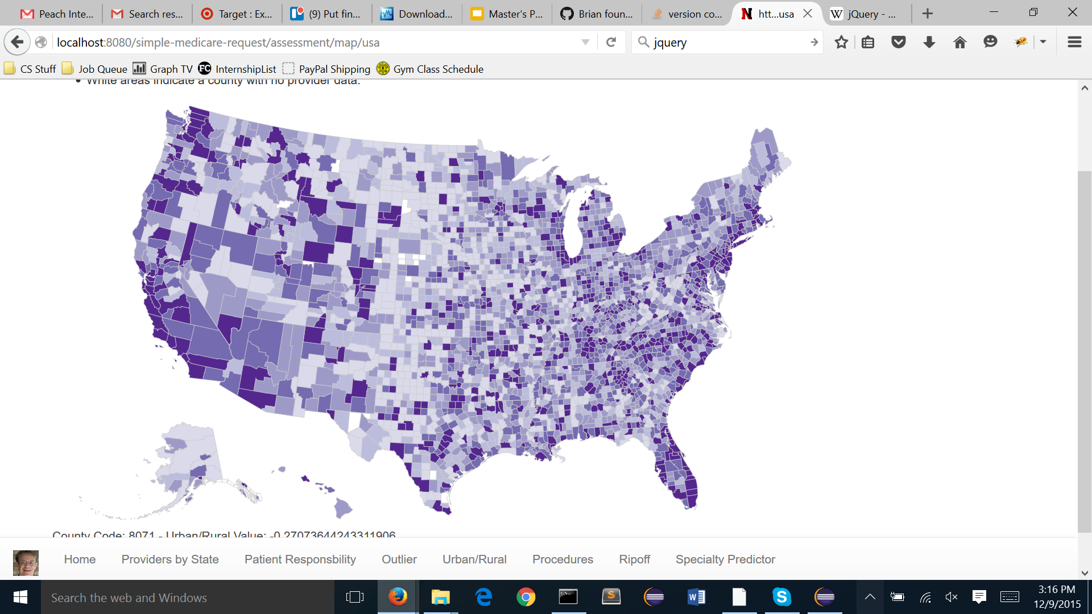
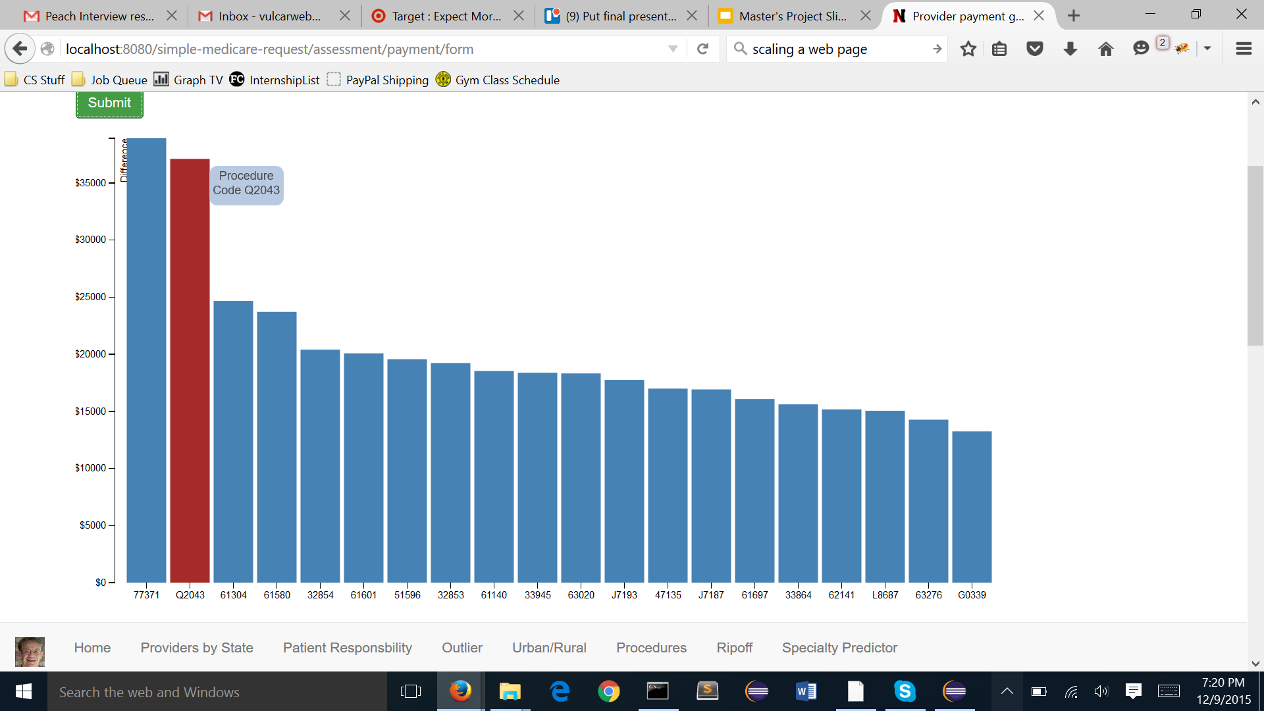
Visualizing Our Data
D3
Uses SVG, HTML 5, and CSS
Portable! Interactive! Free!
Constructing the map
Creates map and adds color on the go
Constructing the chart
Build every piece, left to right

Slide 12

Distributed, scalable, full text search
Notes:
(Doyle)

Slide 13
Solr in a nutshell
Why Solr?
Good for ad-hoc queries and faceting on a large set of data
Free, pretty good wiki and stack overflow coverage of topics
Easy to install, easy to ingest/experiment, good admin UI
How we used Solr:
Sample data ingest done via admin ui (cut/paste csv rows)
Larger ingest done via Java/SolrJ/opencsv
Solr schema defined (= fields, types and how it is indexed/queried)
Included a “bag of words” defined by “keyword rich” fields (description, provider type, code, etc)
Notes:
(Doyle)
Solr is a popular open source search engine - it’s based on the same core search library as Elastic Search.
It allows fast queries on a large indexed data set, with built in processing such as stemming and stop words for free text fields.
It also allows for faceting, which I’ll explain in a minute.
It’s free, it has a relatively good wiki and plenty of people use it, and it’s very easy to install.
It also has a good admin UI that allows for experimentation on the fly. If you had to give a quick demo in a day, you could get Solr up and running and a very simple index built.
At the start, we defined a basic schema for our CSV fields and ingested a small sample set - that was enough to get rolling for our basic use cases. For the next set of use cases, we graduated to the full data set of 10 million rows, and we started using the SolrJ and openCSV libraries for ingestion. And we made a couple tweaks to the schema as we went - mainly to define a bag of words for default queries and to tune some fields for out specific use cases.

Slide 14
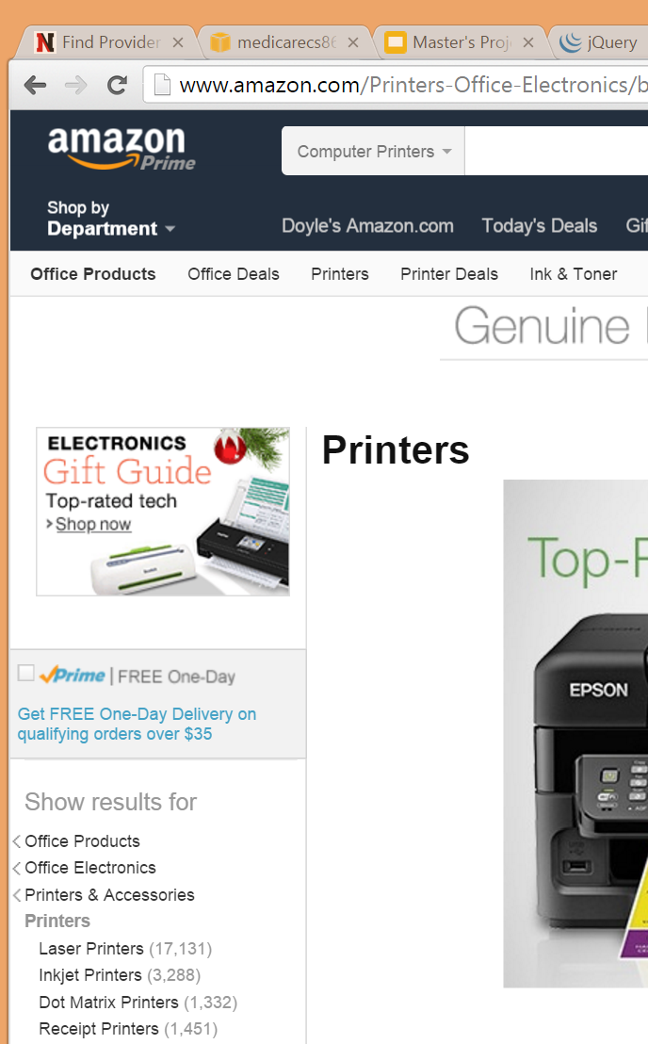
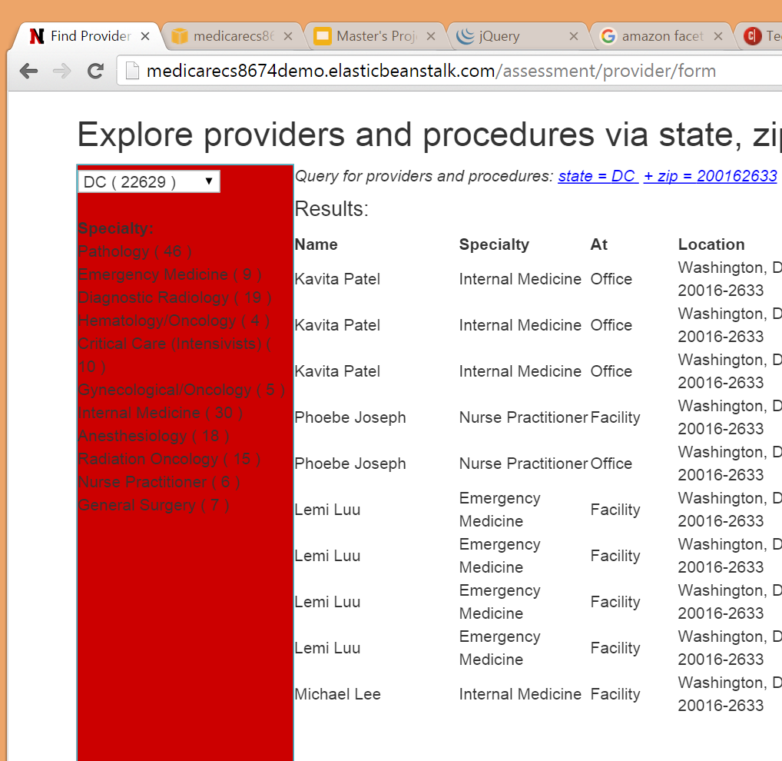
Solr faceting as a navigation aid
Notes:
One of Solr’s big advantages is facet based search. So what is faceting?
Even if you don’t recognize faceting as a search term, I can almost guarantee that you’ve used it. Amazon and many eCommerce sites use it often - it’s a great technique to use when you are trying to help a user navigate a large amount of data in a minimum number of clicks.
So here’s a screen I clipped for Amazon, and and one of our use case pages using facets. The Amazon page shows a couple categories so you can narrow down your printer results - without facets you’d have to scroll through thousands of results.
We used Solr to help the user navigate to a specific provider specialty - first we show them providers by state, then by zip code, then finally by specialty. We could have mixed these up to a different order - specialty first for example, or city instead of zip - finding a provider by state and then zip just happened to be our use case for this page.
Solr does most of the heavy lifting for faceting. The one gotcha is that faceting queries are generally harder to do correctly, but once you get the hang of it, they are very useful.

Slide 15
Solr - looking back
What was easy?
Create a new index in “cloud” mode
Building an index from csv rows
Basic search queries with SolrJ
What took a bit more effort?
Advanced queries using SolrJ
Faceting
Notes:
(Doyle)
And now, after a few months, in retrospect, here’s what was easy, a little harder and harder still with Solr.
The easy parts were getting the basics up and running - very easy to install, get our data ingested and some basic searches working. For example, finding the busiest providers based on a service count field was easy, as was finding procedures based on a keyword in the procedure description.
A little harder was getting faceting to work with state, zip and type of provider, as well as getting those more advanced queries to work with SolrJ and parsing the results - it still wasn’t rocket science, but it took some time.

Slide 16
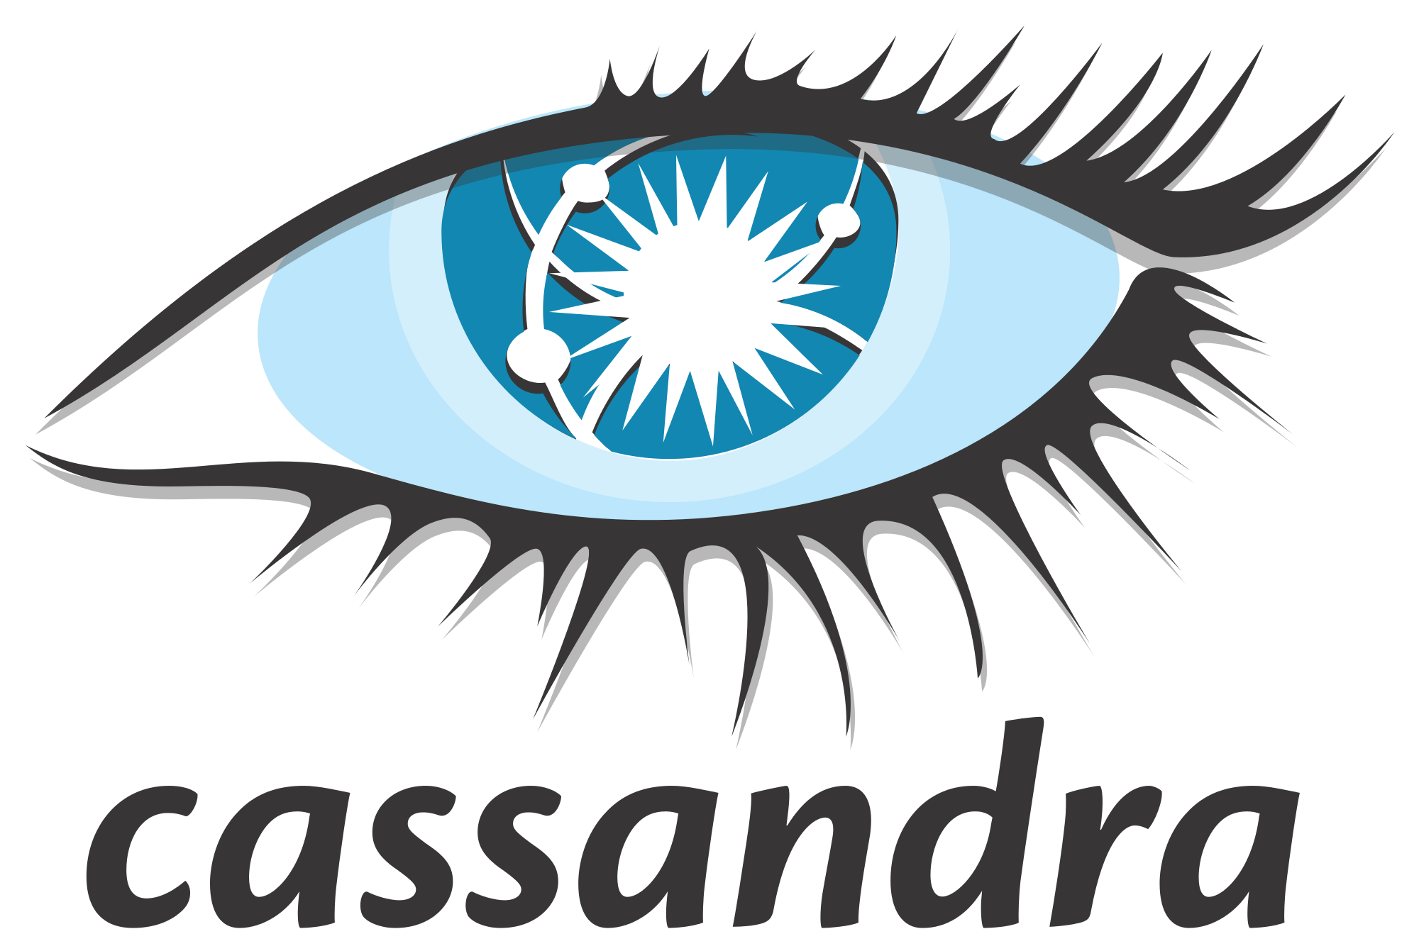
Fault tolerant NoSQL database
Notes:
Tim

Slide 17
What is Cassandra?
Description
Open source non-relational (NoSQL) Database
Column-oriented
Distributed
Advantages
Scalability (distributed, near linear, node symmetry)
CQL (SQL-like query language)
SELECT, FROM, WHERE, ORDER BY (sort of)
but no JOIN, or aggregations (GROUP BY, etc)
secondary indexing
Cassandra Java Driver (similar to JDBC)
Notes:
Cassandra is an open source non-relational (No-SQL) database. Like Googles bigtable or HBase
The big advantage of non-relational databases like Cassandra over traditional databases is that its both free and distributed.
The distributed nature allows the sharing or storage and querying tasks between computers -> horizontal scalability
2 notable advantages of Cassandra over other non-relational databases
Cee Que El - a SQL-like query language. That retains the SELECT, FROM, WHERE, etc structure
many will be familure with, but is more limited in that there are no JOINS or aggregations.
2. Cassandra allows secondary indexing. Rows are distributed between nodes by the hash of the primary key. If you want to retrieve rows based
on a column value the database needs an efficient way of finding them accross nodes. Secondary indexing essentially creates a map so taht
Cassandra can efficiently find the rows accross nodes.
The cassandra java driver is similar to JDBC. If you are familar with JDBC, you know 90% of what you need to use the cassandra java driver

Slide 18
How to use Cassandra
Table Design Principles
It’s all about the table design
maximize speed and minimize replication
denormalization - replicate data
sometimes a new table just for the query
Notes:
With large tables, lookup times can be slow, so in order to maximize performance non-relational database tables are designed to minimize
the number and complexity of queries. For ths reason they break the relational model. They are denormalized and may repeat the same data
across multiple tables.
Good table design is crucial

Slide 19
How to use Cassandra
Use Cases:
Return, in order of cost, the providers with a cost for the procedure above/below a given threshold
Find the Most/Least Expensive Providers for a given state
CREATE TABLE providers_cost (
procedure_code text,
state text,
cost float,
provider_last_name text,
provider_first_name text,
provider_id text,
PRIMARY KEY ((procedure_code), cost, provider_last_name, provider_id)
) WITH CLUSTERING ORDER BY (cost DESC, provider_last_name ASC)
CREATE INDEX ON mv_providers_cost(state)
Notes:
A simplified example from our project shown here. We have the following two usecases.
We want to return in order the cost, the providers with a cost for a procedure above/below a given threshold (used for did you pay to much use case) as well as the
most/least expensive providers for a given state
We set the primary key as follows the information inside the double parens is the partiton key,
this is hashed and determins on which node the row will
recide. the following columns are for ordering
when a row is added to the table it will be inserted in the order designated by these.
So here it will arrange by cost first. For good measure I added the last name, so if two providers have
the same cost they will be listed alphabeticaly
by last name.
provider_id is added because we are creating an aggregate primary key so must be unique.
this puts the table in ther order we need for the first use case. For the second usecase we add a secondary index so that we can select WHERE state = the sate we are quering

Slide 20
Cassandra Conclusions
What we learned
Terry N. Null, O.D.
Experimented with different table designs
What could be improved
Better Data Ingestion Method
More clever usage of secondary indexes and ordering may further reduce the number of tables we utilize
Notes:
What we learned
We ran into typical ingestion issues. Though one caught me off gaurd: Terry N Null caused the table ingestion to fail -> importance of sanitizing data
Did some benchmarking
tried different table formats
our data ingestion was not efficient, it didn't need to be because tables only need to be
written once, but it would be good to streamline this.
now that we created all the tables we need, it would be good to go back over them to
determine if any design changes or secondary indexes can be utilized to reduce the amount of
data replication

Slide 21

Notes:
Brian, Jin, Joshua

Slide 22
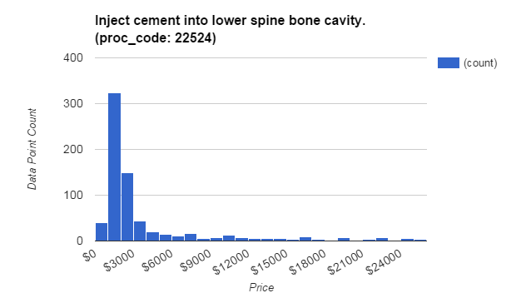
Technique for “did I pay too much?”
Question to answer: how many others paid less than me, for a certain procedure?
Observation on data: charges fits into normal distribution
Notes:
I was working on par of the machine learning caes in the team.
Techniques used for use case “did i pay too much”
Questions to answer:
For a given procedure, if 50% others paid less than me, fine, avg price.
But what if 95 % others paid less than me, probably I’m paying too much!
Observation on Data;
Looking into the charge for each prodecure, I found the price histogram is similar with Normal distribution.
From this chart, you can imagine the point near 3000 is the mean for the Normal distribution.

Slide 23
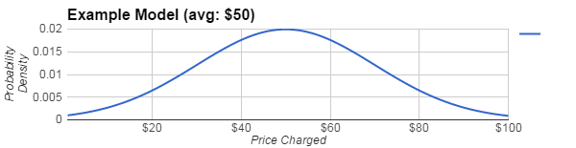
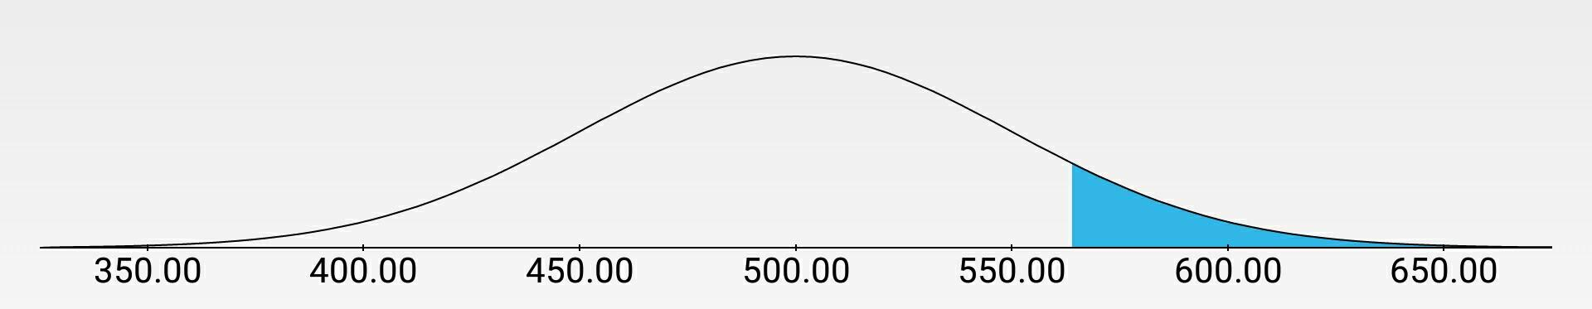
“Did I pay too much?” analysis (cont’d)
Model training
calculate mean and stdev for each procedure code:
alternative: Spark MLlib GaussianMixture, k = 1
Answering query
calculate CDF (cumulative distribution function) for the given price
Example Query : paid $570
Notes:
Model Traning:
With this insight, tranning the models should be calculating normal distirubution for each prodecure.
We have 5000 procedures, which means we have to train 5000 individual models.
One way to do these calculation is using Gaussian mixture class in the spark’s MLlib, which is a macheneleaning library.
The example chart shows how we visualize a model with 50 dollar as average charge.
Answering the query:
involves using CDF to calculate area of section beyond the given price, in the second example chart , the given price is $570.
And with that area, we can tell , for eg. 10 % others paid more than you do.
That’s how we are doing predictions under the hood.

Slide 24

Urban vs Rural Intrigue
Given only medicare data, can we discern more interesting socioeconomic phenomena?
e.g., urbanity vs rurality
Notes:
*image from: http://www.bls.gov/opub/btn/volume-2/images/2-5-image.jpg

Slide 26
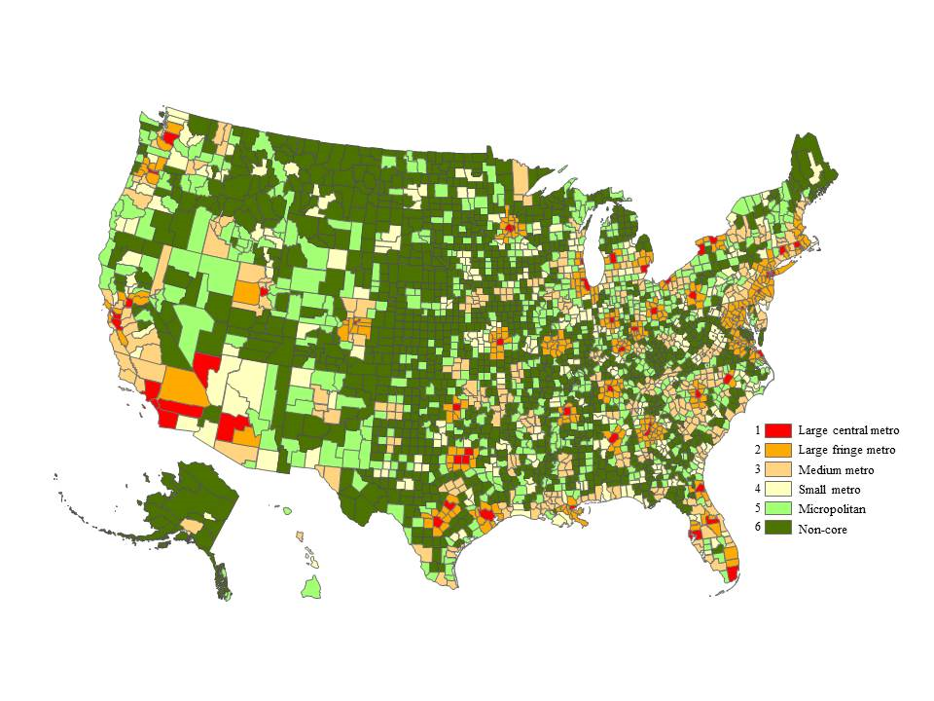
Our Map vs CDC Map
(inverse colors)
Notes:
*image on the right from: http://www.cdc.gov/nchs/images/popbridge/URv3.png

Slide 27
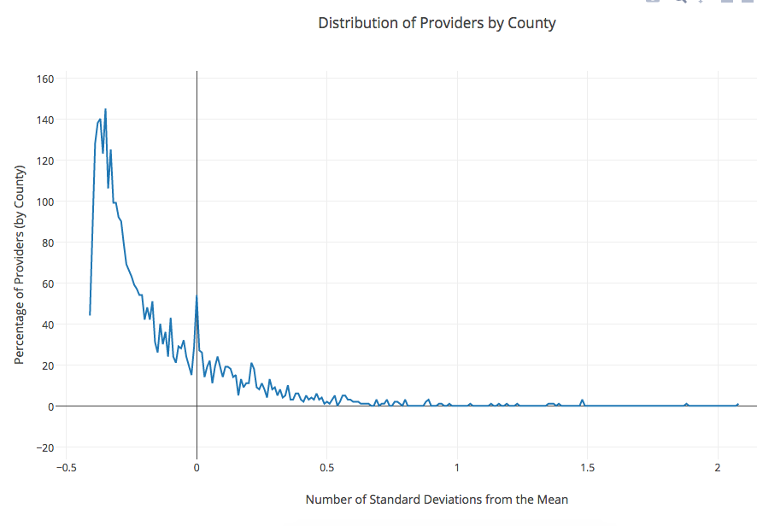

Slide 28
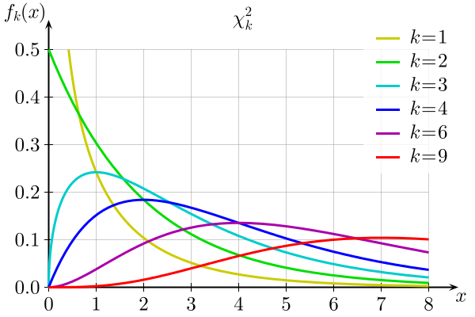

Slide 29
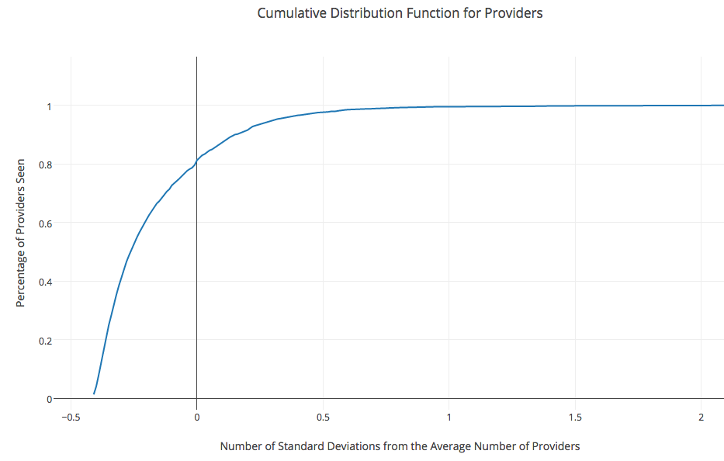

Slide 30


Slide 31
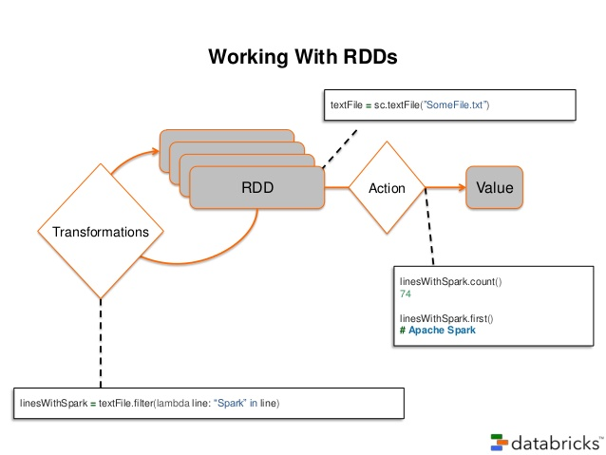
What is Spark?
Distributed computation engine for “big data” processing
Supports in-memory computing
Well-supported, with a wide variety of compatible libraries
MLlib, GraphX, Streaming, SparkSQL, and many more
Easy-to-use syntax, available in Scala, Python, and Java
Data model based on Resilient Data Structures (RDDs)
Goal is to introduce fault-tolerance to in-memory processing
Allows spilling to disk when memory is exceeded
RDDs store a lineage which allows any RDD to build itself in case of failures
The set of available transformations (map, filter, etc) operate lazily, and can only reference an RDD that has not failed
Notes:
In-memory computing: Can run up to 100x faster than Hadoop, allows caching of data to cut down on reloading. Very mem-intensive, however, enough mem means one data ingest then everything else is lightning fast

Slide 32
Specialization Predictor:
Naive Bayes Text Classifier
Question: Given some text describing a medical procedure, can we determine the type of doctor that provides this service?
Solution: Train a Text classifier using the HCPCS Descriptions in our data
Text Classification: Given a “bag of words,” each with a label. Which of the words in the bag best predict that label?
Model: Term Frequency - Inter-Document Frequency (TF-IDF)
Weigh the frequency of words in a single document, with their frequency across all documents in the corpus

Slide 33
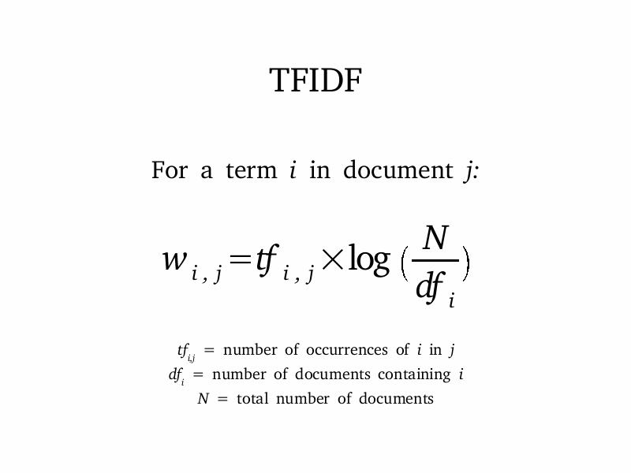
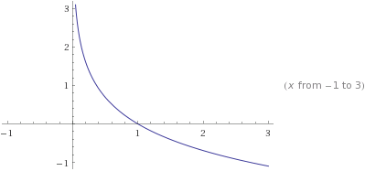
The TF-IDF Model
Two Steps
First, compute term frequency for each document
Next, using the entire corpus of TF documents, fit them to the IDF model
TF-IDF values are computed for each word in each document, generating a sparse matrix over all documents
Posterior probabilities are computed for this Matrix
The max probability is used to determine the predicted label for a given Vector of TF-IDF values
Notes:
How’d it go?
Somewhat well for a “naive” (pun intended) implementation. Naive Bayes is very easy to implement and is usually the first choice for classifiers due to that
In our case, the initial Naive Bayes approach hit about 50% acc (i.e. on sparse vectors of HCPCS codes)
TF-IDF adds significant complexity, especially when considerations are taken for proper tokenization
We did not use a tokenizer, just basic regex replace
Tokenizing, key word processing, gram, n-gram, etc can significantly help
The data has some pretty large limitations
Only a handful of labels, some very generic
Labels are ascribed by the majority of procedures done by a doctor
This means any two provider types can have some of the exact same text
Significant words are still not very prevalent
Aggregation helps, but the uniformity of descriptions boosted the effects of
basic words like “and”, “by”, “but”, etc.
Next steps, implement more advanced NLP, compare results of aggregation vs no aggregation,
filtering of “bad words”, compare multinomial vs binary multinomial
Could see an increase in efficiency here

Slide 34

Suite of deployment tools, data tools, and more for deploying code on the Amazon cloud
For our project, we utilized:
S3: Simple Storage Device
Data storage on the cloud
EC2: Elastic Compute Cloud
Cluster Computation on the cloud
EBS: Elastic Block Store
Fully portable “disk” storage to store Cassandra and Solr instances
Elastic Beanstalk
Cloud hosting environment for web apps

Slide 35

S3: Simple Storage Service
Amazon cloud storage service
Directly accessible file system through EC2 clusters (s3://<BUCKET-NAME>/…)
Spark, Hadoop, etc can access s3, making this a great place to store raw data, logs, etc.
Elastic Block Store
Mountable, persistent “drive” storage
Used as a hard disk which can be mounted directly to an EC2 instance
For our purposes, we loaded our Solr and EC2 instances onto an EBS volume
This volume could be transferred to new clusters and persists after cluster termination

Slide 36



EC2: Elastic Compute Cloud
EC2 is Amazon’s cloud based server architecture
Allocate clusters pre-loaded with distributed computing technologies
Pre-built with Hive, Hadoop, Spark, etc.
Allows cost-effective deployment and development of big data driven applications
EMR: Elastic Map Reduce
Computation-focused, based on EC2
Elastic Beanstalk is a managed hosting environment for web apps
Languages
Java, .NET, PHP, Node.js, Python, Ruby, Go
Web servers
Apache, Nginx, Passenger, and IIS.

Slide 37
Scalability
UI and web service stateless to allow for more user requests
Used services and products that had distributed scalability built in
but…
Kept instances forced to one, since more instances cost more $$
Could have cached a few queries that are the same for all requests (state dropdown)

Slide 38
Next Steps
Automatic and annual ingestion
Solr/Spark text tokenizing
Authorization: admin write, user read only
More ML for deeper analysis
Portable/Mobile
Add security to backend servers
More use cases…
Notes:
Ingestion was somewhat manual - us kicking off a process to get csvs loaded
Would like to use Solr to process descriptions and clean out any weird characters, synonyms, and generic words
then use Spark to process that data
Hunter’s Next: OAuth, Mobile/Portable, Waiting on long term processes, visualizing ML stuff
Unit testing?
OAuth2 & hook up Solr/Cassandra authorization (differentiate who can write versus who can read)
Spark for ingestion?
“Async” flow for longer queries (ie: query via spark, create temp table, then tell user minutes later that it’s done)
Solr - synonyms for procedure keywords?
plenty more analysis scenarios
SPARK/SOLR TEXT TOKENIZING
Would like to use Solr to process descriptions and clean out any weird characters, synonyms, and generic words
then use Spark to process that data

Slide 39
Questions?

Slide 40
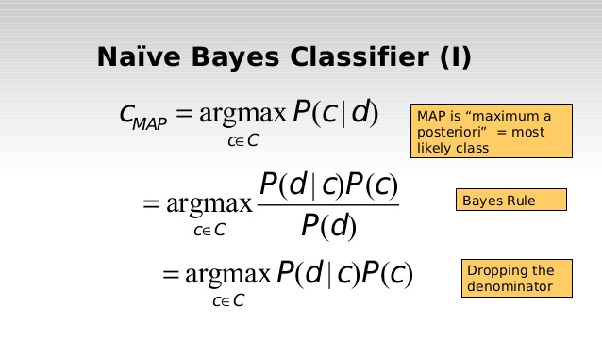
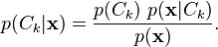
What is Naive Bayes
What’s so naive about it?
Assumes independent events
Bayes Theorem:
Key component is the numerator
It is proportional to Posterior probability
Classifier needs a decision rule
Maximum A Posteriori (MAP),
Pick the maximum probability (maximize the numerator)
Multinomial Naive Bayes
Each record is a “histogram” of occurrence frequencies (e.g. word counts)

